Slide 1
Aviation Consulting Group
Group Members:
Kushal Shah, Dishank Solanki, Yicun Deng, Roderick Cushing

Slide 2
Table of Contents
Objective
Understanding data
Business Questions
Answering Business Questions
Recommendations
Conclusion

Slide 3
Objective
Aviation Consulting group is here to:
Examine Southeast Airlines and its regional partners to identify which airlines do not perform well
Identify the issues with airlines that do not perform well
Examine which characteristics of customers and flights tend to have a positive and negative impacts on a recommendation score
Recommend solution to improve performances of these airlines

Slide 4
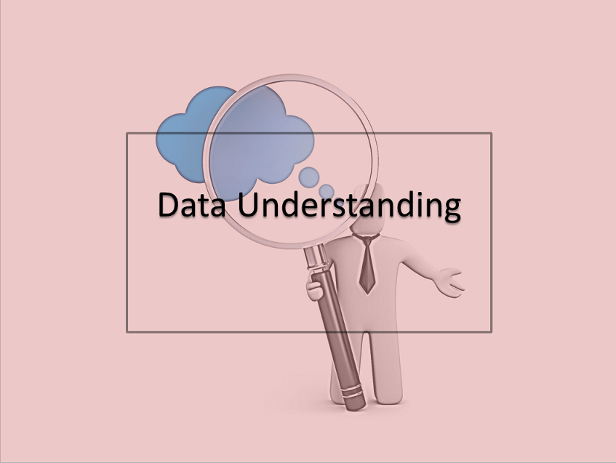
Understanding the Data
Destination
Origin
Amount Spent on Shopping
Date of Travel
Airline
Scheduled Departure Hour
Age
Gender
Year of First Flight
Type of Travel
Loyalty Status
Type of Travel
Net Promoter Score
Likelihood to Recommend
Flight Distance
Delay in Arrival
Delay in Departure
Flight Time
Evaluation Metrics
Customer Attributes
Travel Attributes
Flight Attributes

Slide 5
Business Questions
What are some basic consumer trends with recommendation scores?
Which partnered airlines has the most amount of low recommendation?
Why does this airline to have the most cancelled flights?
Which partnered airlines has the most flights cancelled?
Why does this airline have the most amount of low recommendations?
What is the net promoter score for each airline?
What are the customer and flight characteristics that impact NPS?

Slide 6
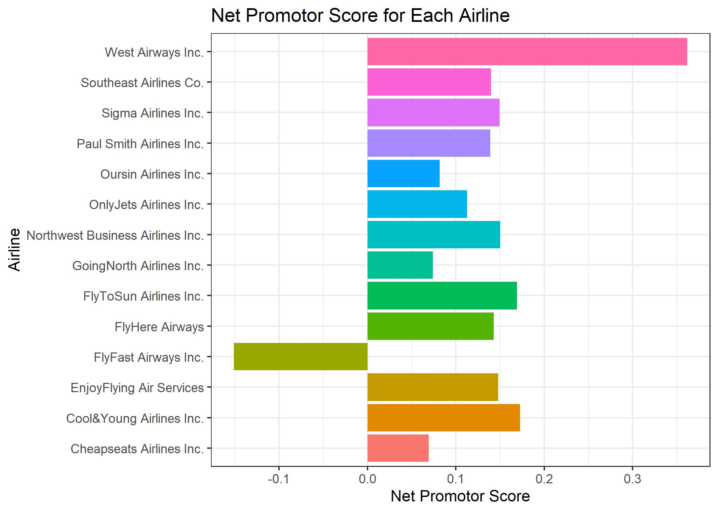
What is Net promoter score for each airline?
Key Points to Note:
FlyFast Airways being the only airline with a negative NPS
West Airways being the best airline in terms of NPS

Slide 7
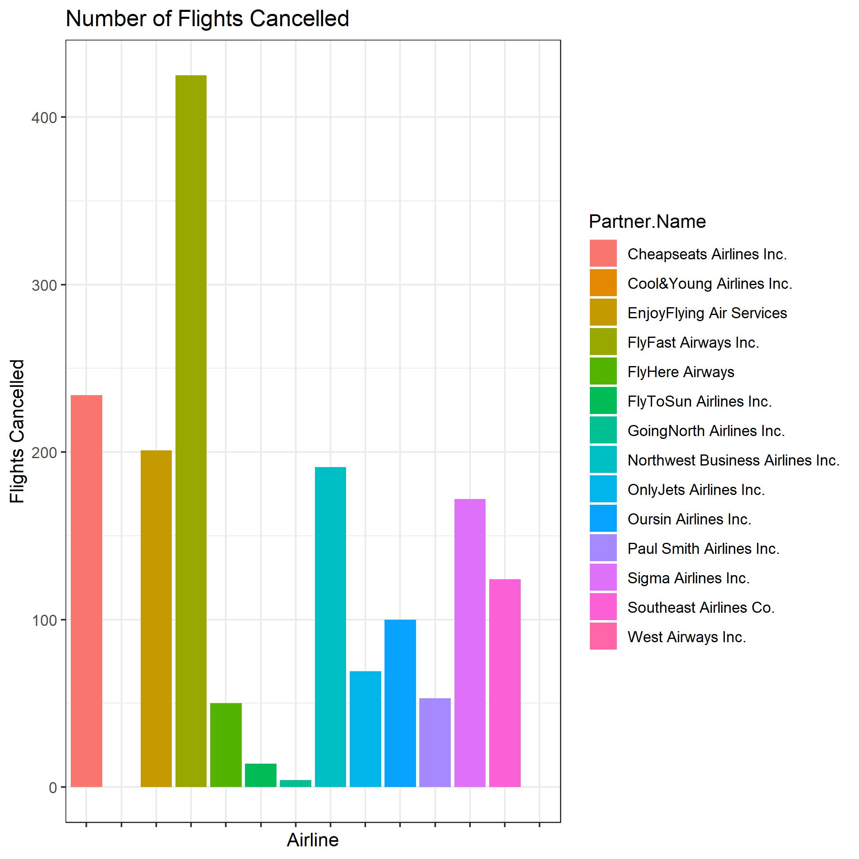
Which partnered airlines has the most flights cancelled?
Key Points to Note:
Flyfast Airways Inc. has the most flights that have got cancelled

Slide 8
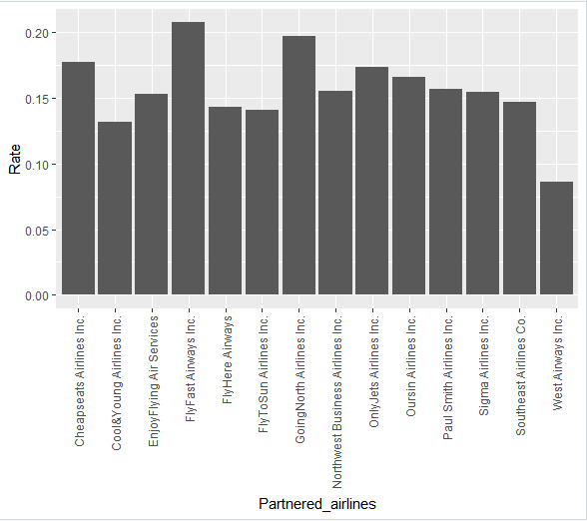
Which partnered airline had the most amount of low recommendation?
Key Points to Note:
FlyFast Airways Inc. has most percentage of low recommendation from customers

Slide 9
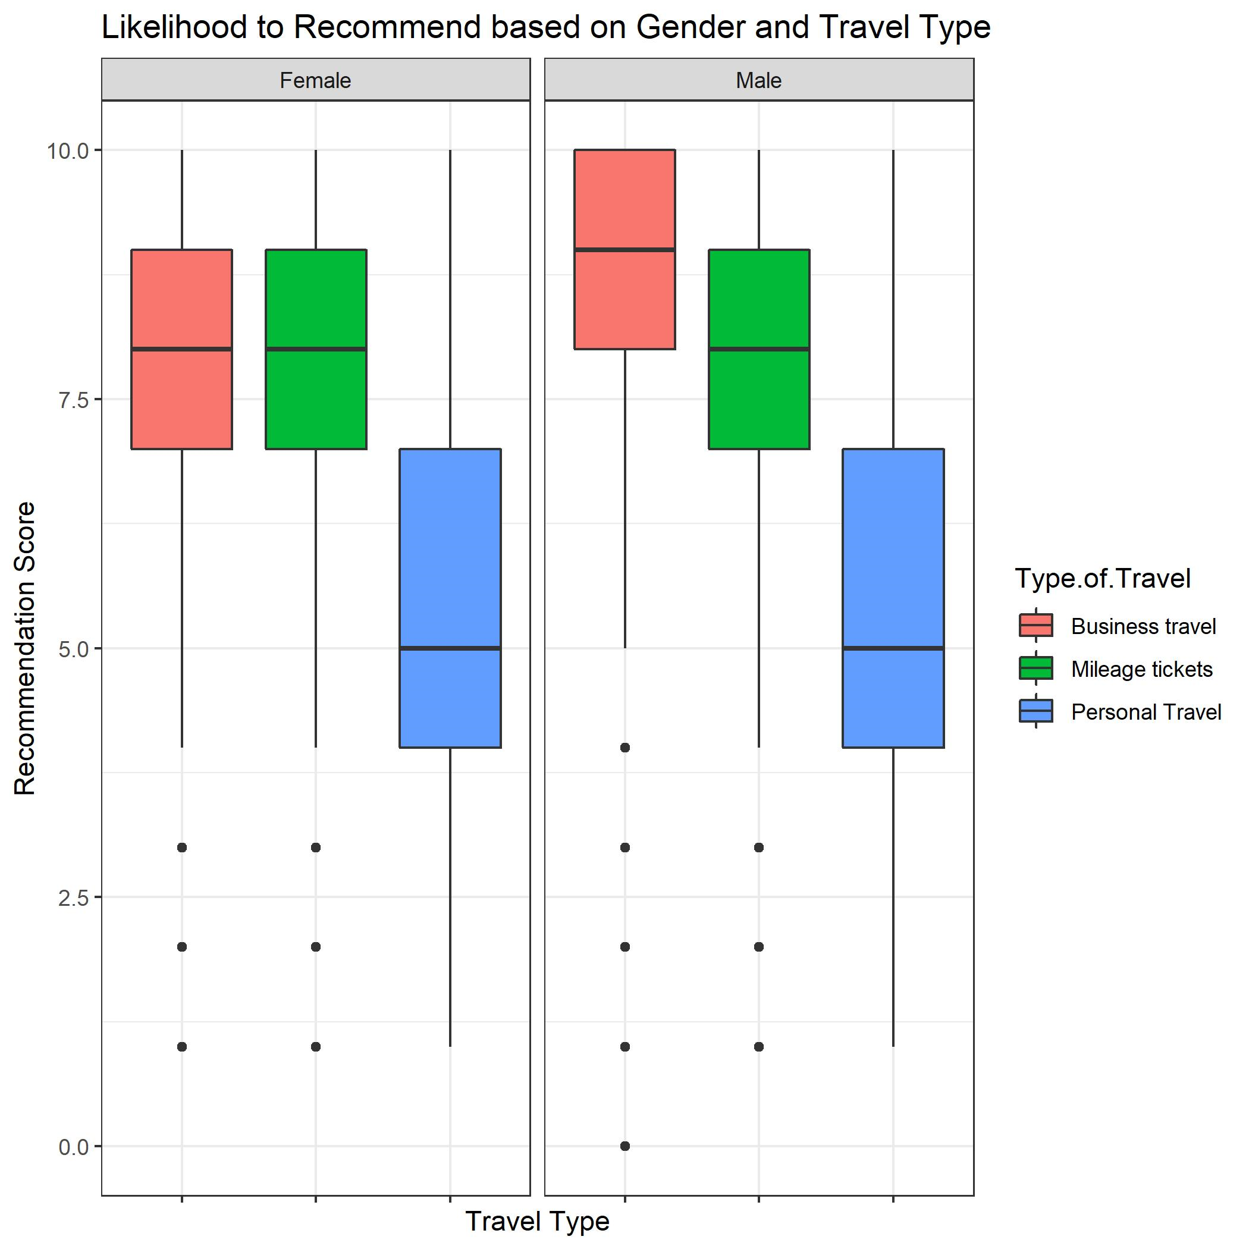
How is Likelihood to recommend related Gender and Travel Type
Key Points to Note:
Customer travelling for business reasons tend to provide higher recommendation scores.
Customer travelling for personal reasons tend to provide lower recommendation scores.

Slide 10
Identifying the Issue
Based of our initial exploration we decided to focus on 2 aspects:
Identifying Areas to Improve FlyFast Airways
Identifying Customer and Flight Aspects

Slide 11

Why FlyFast Airways have the most cancelled flights?
From our data modelling we determined the following aspects that lead to FlyFast Flights that tend to be cancelled are:
Flights Originating from:
Georgia
Texas
Illinois
Flights with a Flight Distance being “Short”
Flights during the beginning of a month

Slide 12

Why FlyFast Airways have the most amount of low recommendations?
With our association rules model we determined the following aspects that lead to FlyFast Flights that tend to receive low recommendation scores:
Female Customers
Customers with an Airline Status of Blue
Customers travelling in Economy Class

Slide 13
What are the customer characteristics that impact NPS?
With our linear regression model we identified the following aspects related to the customer that lead to customers providing higher recommendation scores:
Younger Customers
Travellers with a Lower Loyalty Rating
Male Customers
Among the reasons the travel, customer travelling for business reasons tend to provide higher recommendation scores.

Slide 14
What are the flight characteristics that impact NPS?
With our linear regression model we identified the following aspects related to the flight that lead to consumers providing higher recommendation scores:
Flights with a Higher Price Sensitivity
Flights that tend to be Slightly Longer
Flights that are Scheduled Later in the Day

Slide 15
Our Recommendations For FlyFast Airways
Focus on improving the services and experiences for customers travelling in Economy Class
Attempt to limit the number of short flights provided, particularly from Texas, Illinois, and Georgia.
This does not mean to not have any short flights or flights originating from these states
We simply believe reducing the number of flights within this criteria can improve FlyFast Airlines Net Promoter Score

Slide 16
Predicting Recommendation Scores for FlyFast Airways
As we have clearly identified, FlyFast Airways is the airline that requires the most improvement
We created a model that would predict if a customer would be a Detractor, Passive, or a Promoter
This model had an accuracy of approximately 64%
The model is a solution as it can be used to identify customer needs
Will help FlyFast airways to identify the customers that it should focus on for its marketing efforts

Slide 17
Our Recommendations For All Airlines:
Marketing efforts should be focused towards a younger male audience looking to travel for business
We believe there is an emerging market that airlines can benefit in the form of a new workforce
This entail those young adults who are currently just entering the workforce and have not flown much
Increase the number of flights later in the day and flights that tend to be longer

Slide 18
Conclusion
We strongly believe in our analysis and modelling revealing key aspects that can help Southeast Airlines and their regional partners
We hope our focus on FlyFast Airways can help improve the performance of this airline, bring it up to the standard of the other airway
We hope our recommendations strongly help in improving the overall Net Promoter Score for each airline

Slide 19

Any Questions ?

